Slide 1
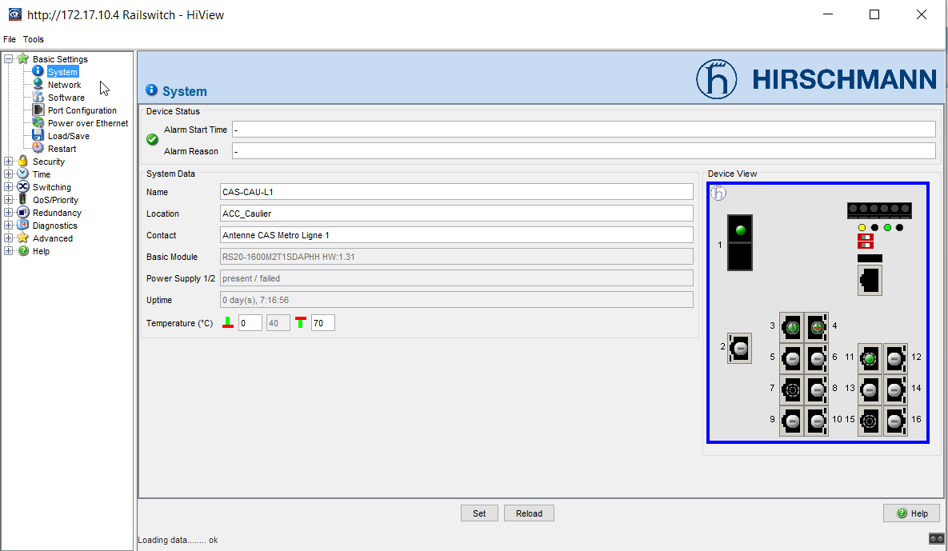
HiView -

Slide 2
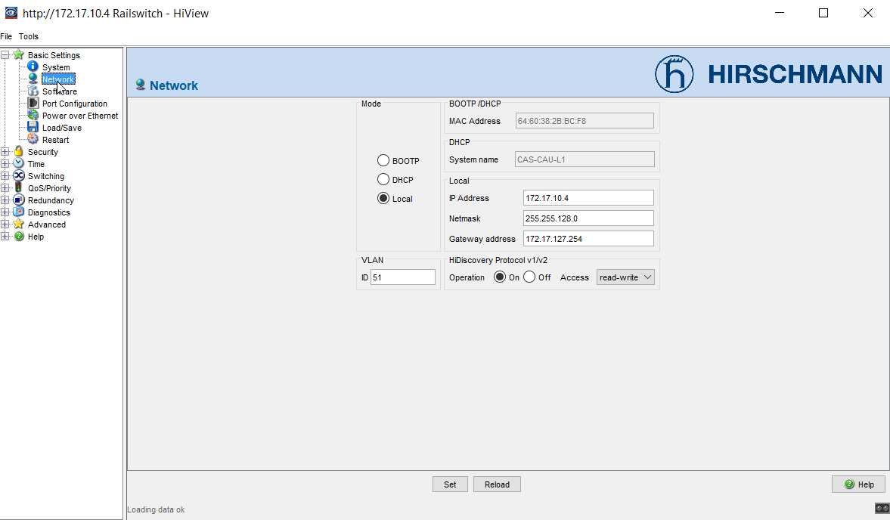
http://172.17.10.4 Railswitch - HiView

Slide 3
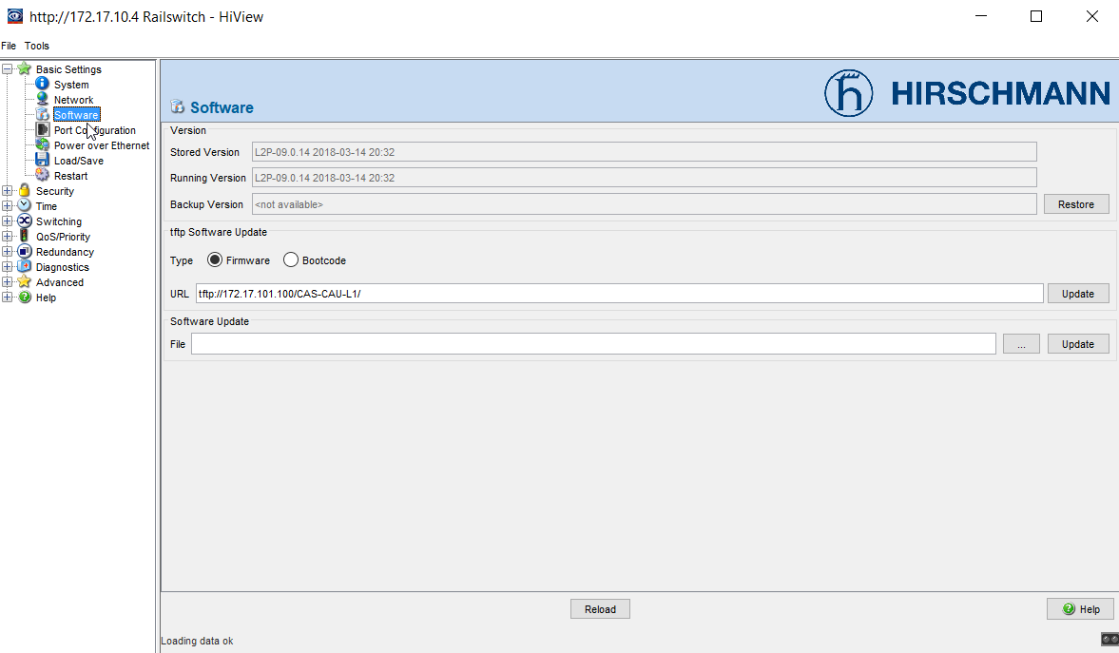
http://172.17.10.4 Railswitch - HiView

Slide 4
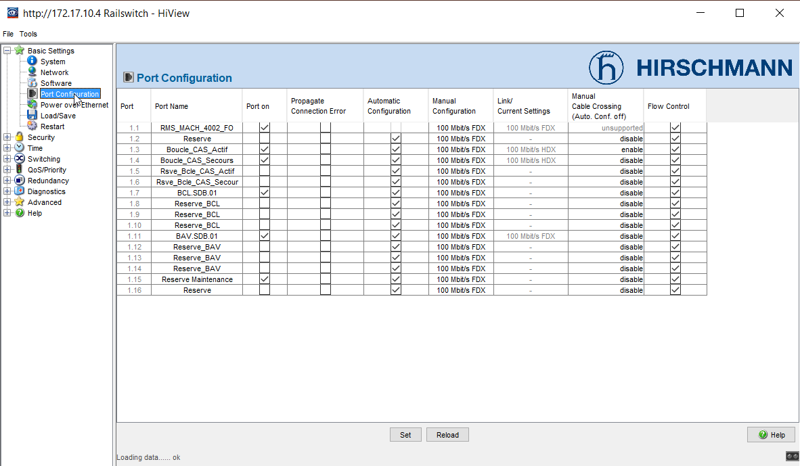
http://172.17.10.4 Railswitch - HiView

Slide 5
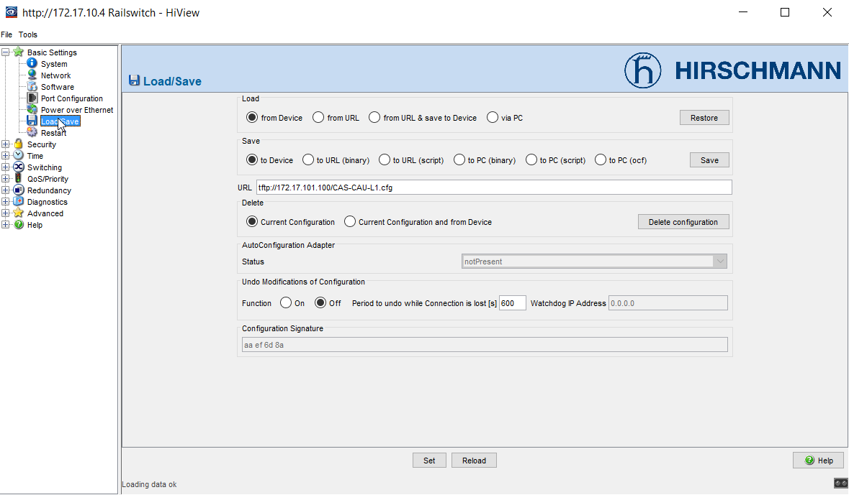
http://172.17.10.4 Railswitch - HiView

Slide 6
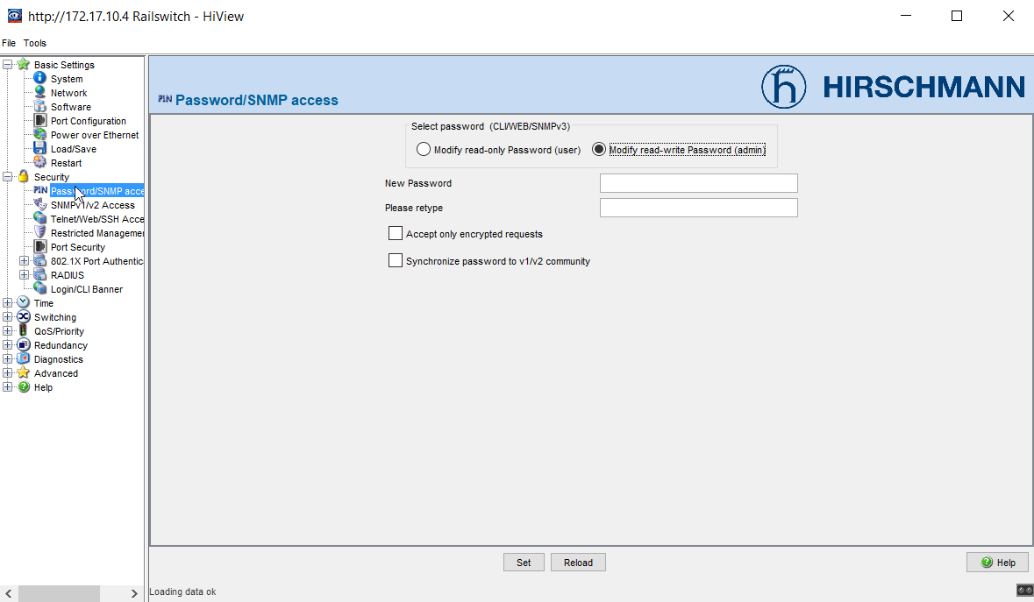
http://172.17.10.4 Railswitch - HiView

Slide 7
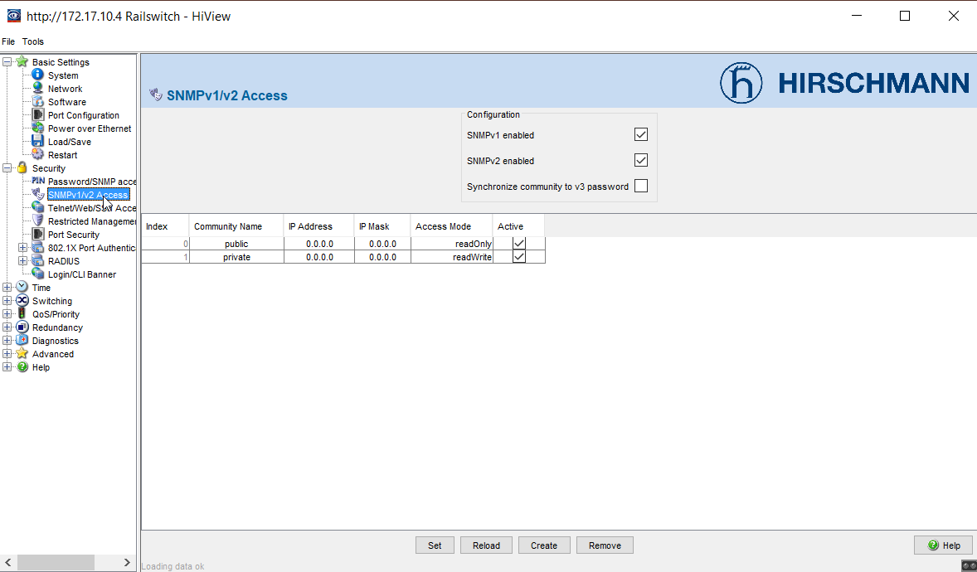
http://172.17.10.4 Railswitch - HiView

Slide 8
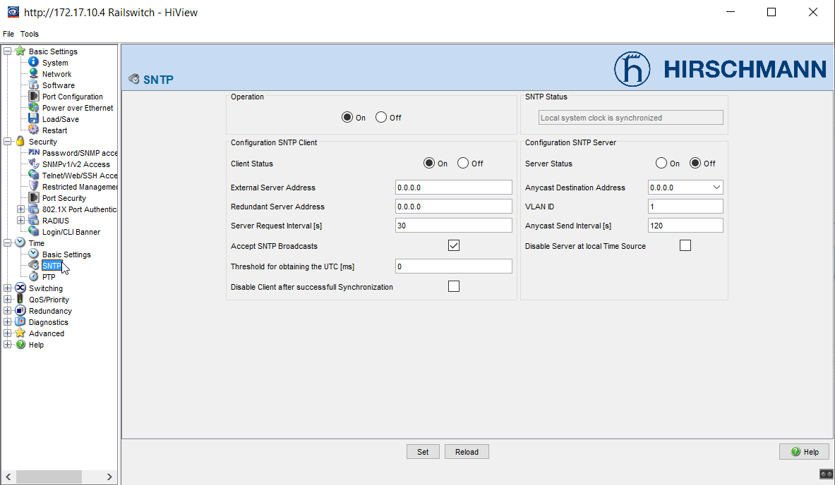
http://172.17.10.4 Railswitch - HiView

Slide 9
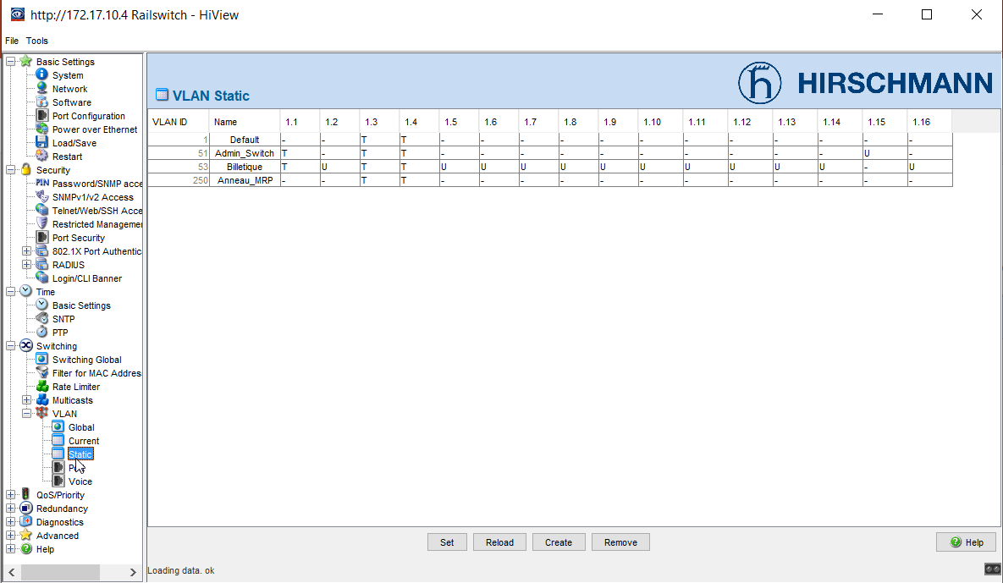
http://172.17.10.4 Railswitch - HiView

Slide 10
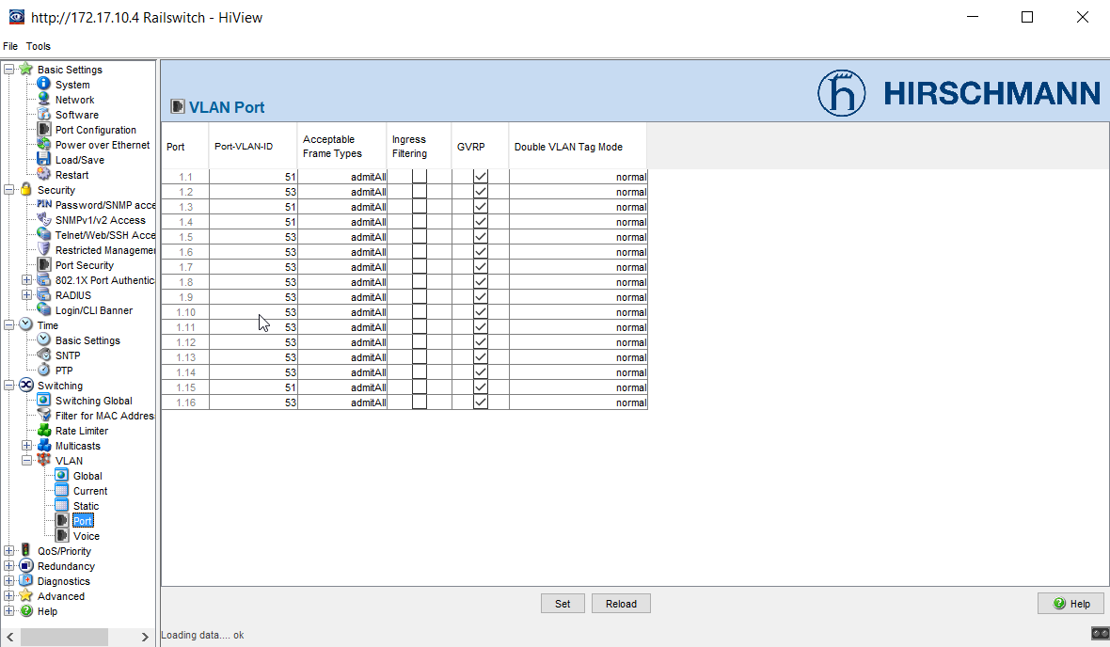
http://172.17.10.4 Railswitch - HiView

Slide 11
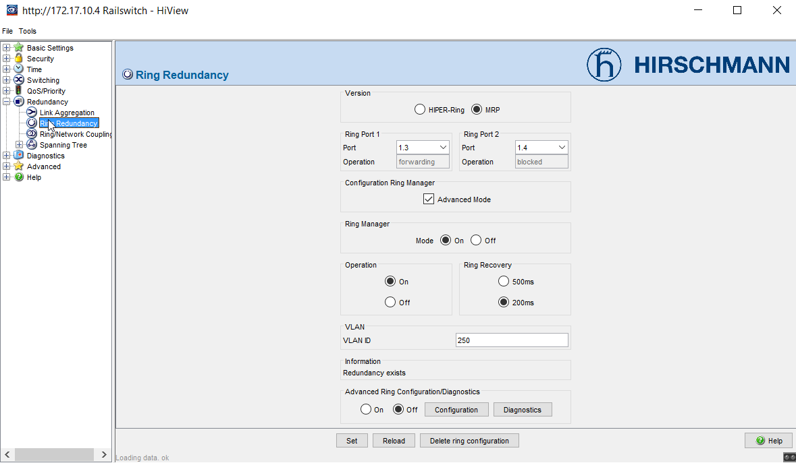
http://172.17.10.4 Railswitch - HiView

Slide 12
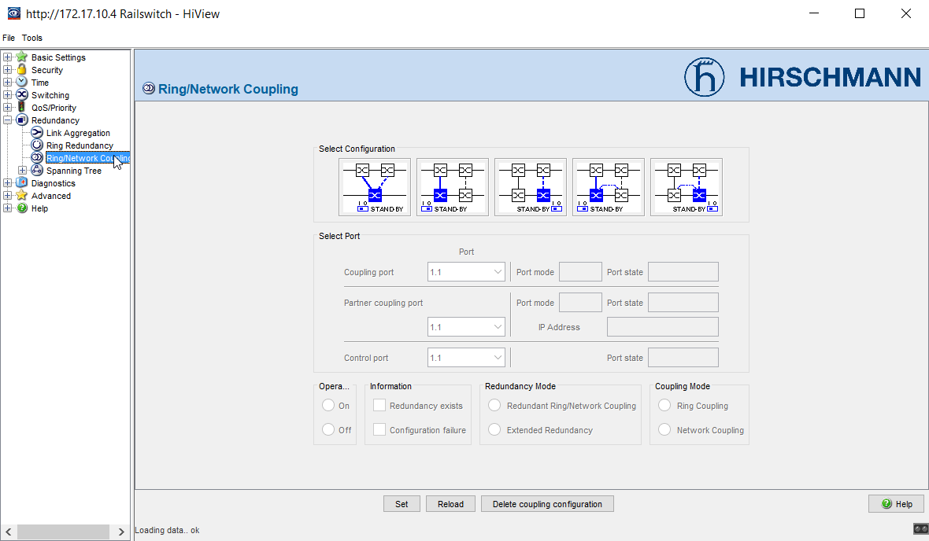
http://172.17.10.4 Railswitch - HiView

Slide 13
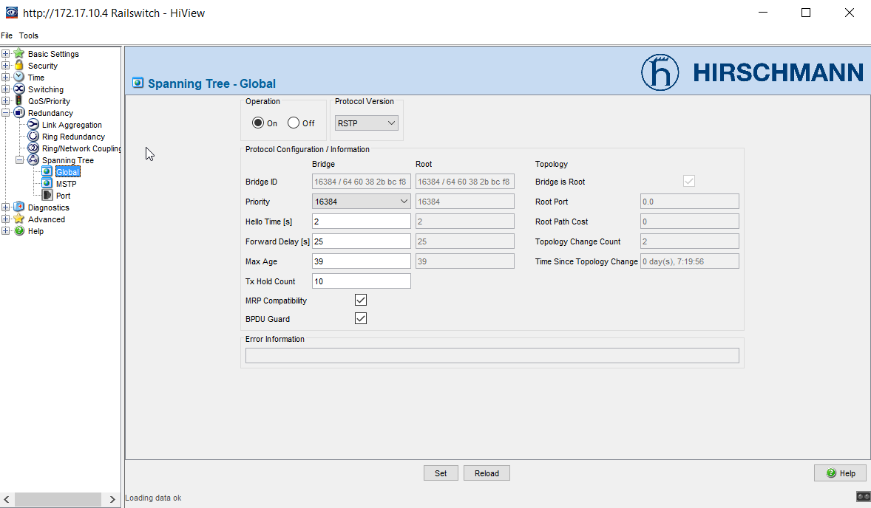
http://172.17.10.4 Railswitch - HiView

Slide 14
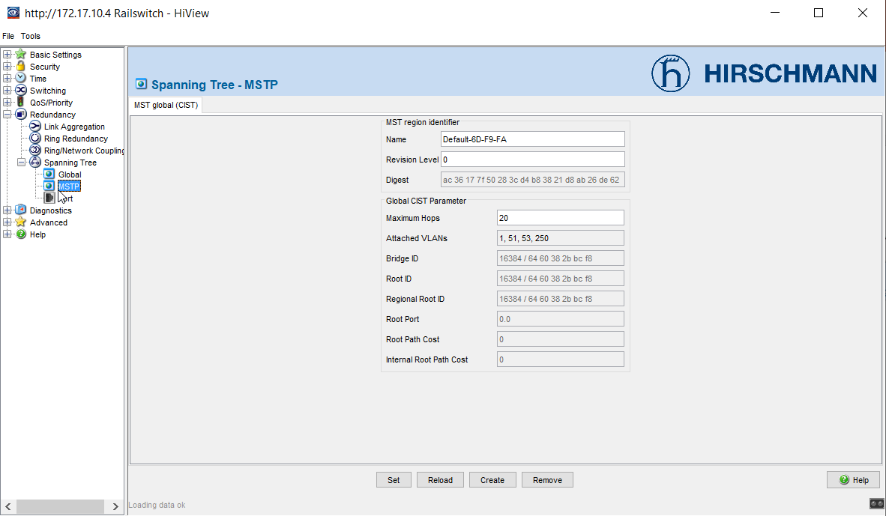
http://172.17.10.4 Railswitch - HiView

Slide 15
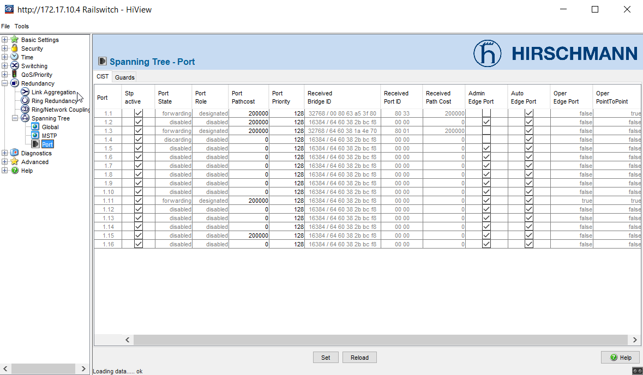
http://172.17.10.4 Railswitch - HiView

Slide 16
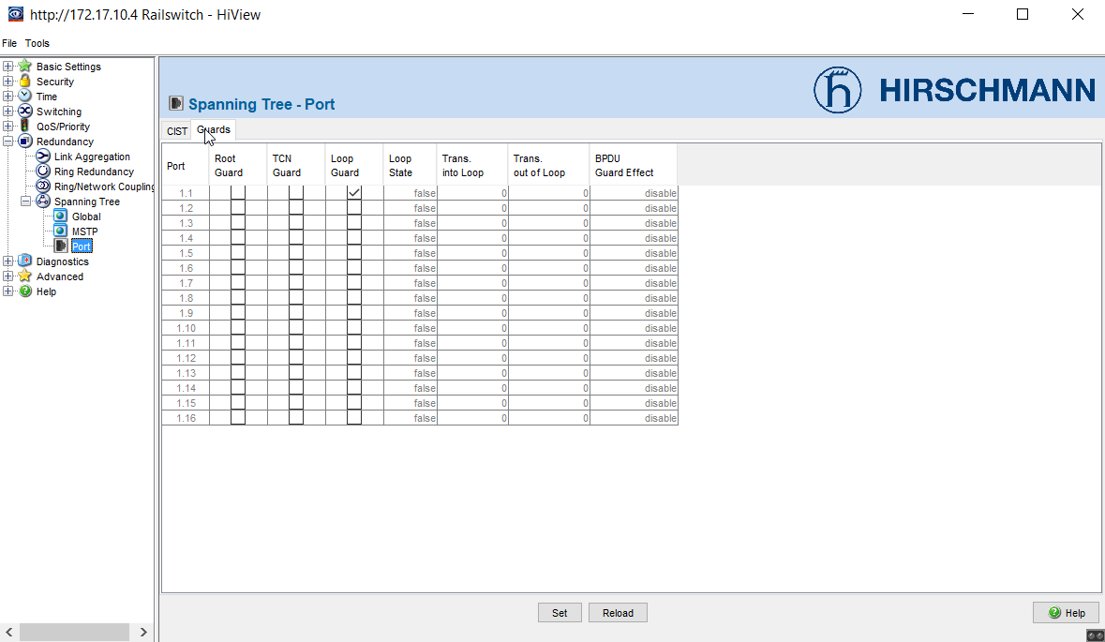
http://172.17.10.4 Railswitch - HiView

